Slide 1

Evanki Unisex Salon
Business Plan & Market Research Report (2025–2029)
Bahjoi, Uttar Pradesh | Owner: Etisham Siddiqui | Contact: +91 92863 40871
Prepared by: Seema Acharya

Slide 2






Executive Summary
Market Opportunity
Business Model
Funding & Growth
Indian salon industry valued at ₹65,000 Cr (2024), growing at 10–12% CAGR. Beauty services market projected to reach $22.99 Billion by 2033.
Premium-yet-affordable unisex salon offering hair extensions, patches, nail art, and advanced skin care. Current revenue: ₹1–1.5L/month with 60% repeat customers.
Seeking ₹10,00,000 to achieve 4x revenue growth, establish 5+ branches in North India within 5 years, with 40%+ ROI and break-even in 10–12 months.
Our Objective
This report analyses the current beauty salon market, identifies lucrative growth opportunities, benchmarks against key competitors, and presents a profitable expansion strategy for Evanki Unisex Salon.
Business at a Glance
Location: Bahjoi, Uttar Pradesh
Investment per outlet: ₹10–15L
Stage: Early growth (1–2 years)
Core values: Hygiene, certified staff, premium products, and affordability
Monthly footfall: 125 customers
Team size: 6 certified staff members

Slide 3






Market Overview & Segments
Indian Salon Market (2024): ₹65,000 Crores
Rising Male Grooming
Premium Organic Products
Growing acceptance and demand for male grooming services across urban and semi-urban markets
Increasing consumer preference for natural, chemical-free beauty products and treatments
Social-Media-Driven Demand
Youth Seeking Trendy Services
Instagram and digital platforms driving awareness and creating new beauty trends
Younger demographics demanding contemporary styling and advanced treatments
Service Revenue Distribution
Hair Care – 40% (dominant segment)
Target Customer Mix
Skin Treatments – 25%
Urban Women: 45%
Grooming Services – 15%
Men: 35%
Nail Services – 10%
Spa & Wellness – 10%
Students & Youth : 20%
High-Growth Segments & Opportunity
35%
30%
25%
20%
Premium Treatments
Male Grooming CAGR
Nail Care CAGR
Bridal Services CAGR
Annual growth in luxury service segment
Fastest-growing customer category
Emerging high-margin service
Seasonal high-value segment
Regional Advantage: North India commands 40.14% market share, with Uttar Pradesh showing the highest beauty market growth at 20%. Evanki is strategically positioned to capture this expanding opportunity across all high-growth segments.

Slide 4
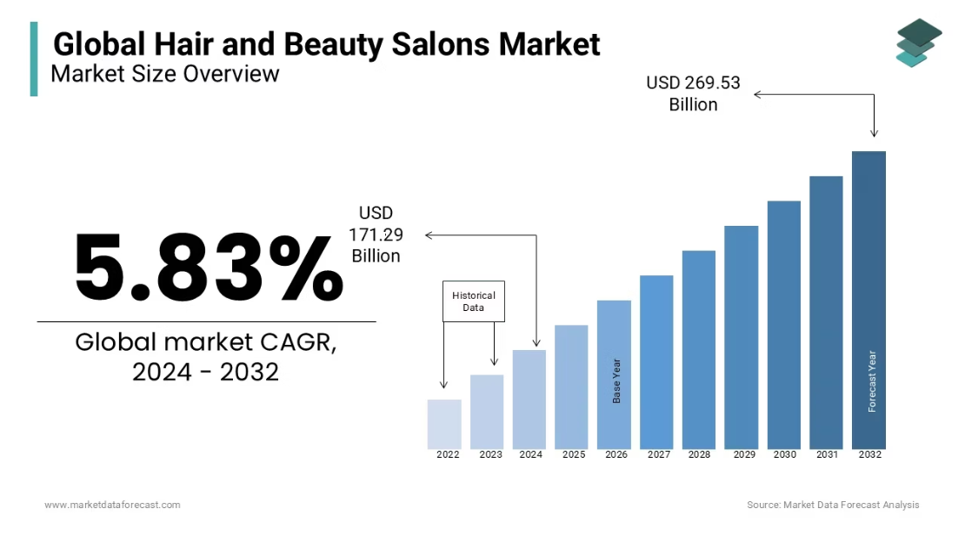
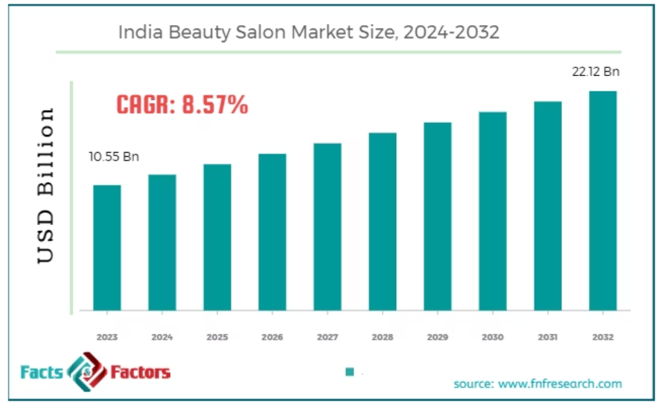
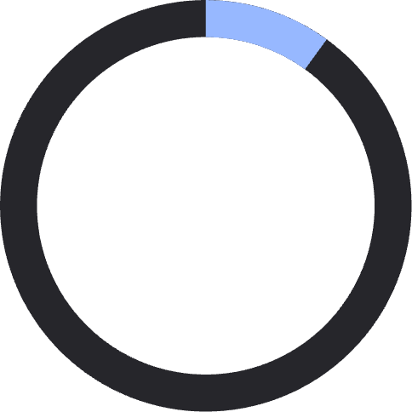
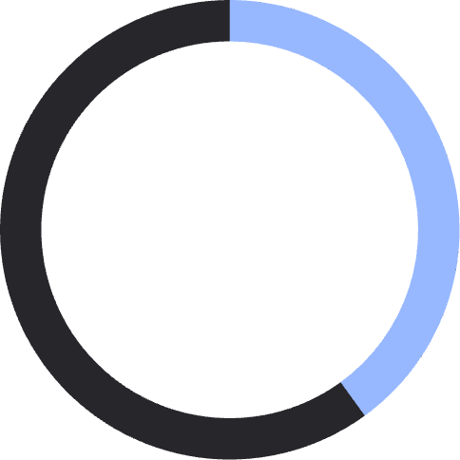
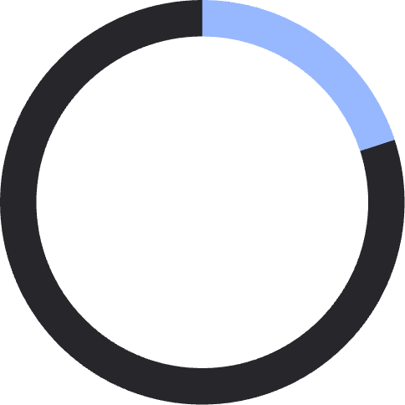
Market Size & Opportunity (2024–2032)
The Indian beauty and personal care market is experiencing explosive growth, driven by rising disposable incomes, urbanisation, and changing lifestyle preferences. The following projections demonstrate substantial opportunities for salon businesses.
Market Growth Trajectory
Regional Market Distribution
The chart illustrates consistent year-on-year expansion, with the market poised to nearly double by 2032, creating significant revenue opportunities for established players.
Regional analysis shows North India's commanding position, with Uttar Pradesh representing the fastest-growing state market—ideal for Evanki's expansion strategy.
10%
40%
20%
Industry CAGR
North India Share
UP Growth Rate
Sustained annual growth rate through 2032
Largest regional market by volume
Highest state-level expansion

Slide 5
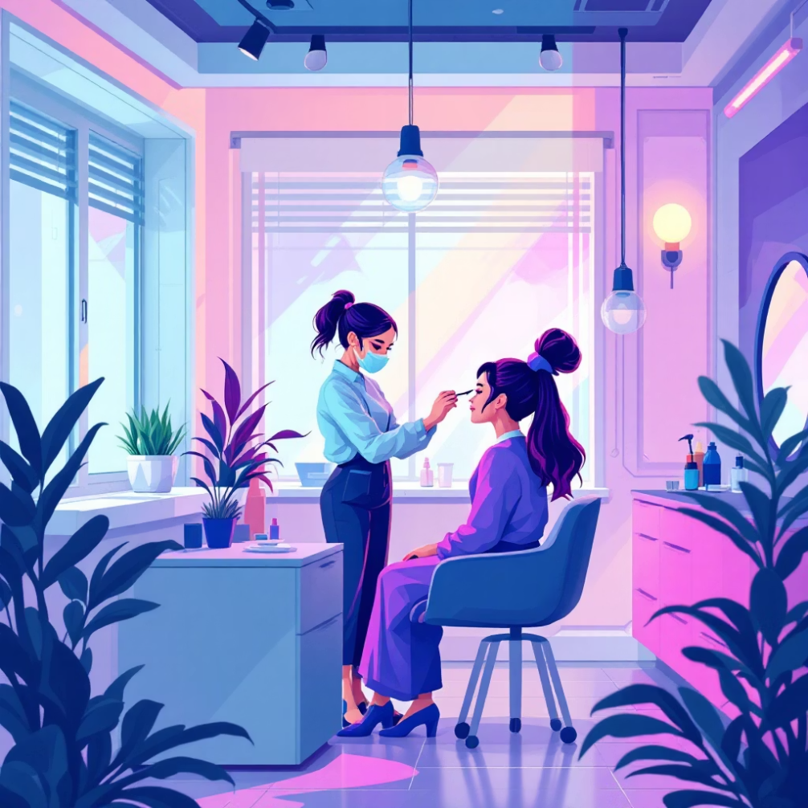
Services & Unique Selling Propositions
Comprehensive Service Portfolio
Hair Services
Professional hair extensions
Hair patches and wigs
Cutting, styling, and colouring
Advanced hair treatments
Nail Services
Nail art and design
Nail extensions (gel & acrylic)
Manicures and pedicures
Nail care treatments
Skin & Beauty
Facials and skin treatments
Makeup and bridal packages
What Sets Us Apart
Waxing services
Specialized spa treatments
Certified Beauticians
All staff hold professional certifications and receive ongoing training in latest techniques
Premium Offerings
Brazilian waxing
Premium Products
Advanced skin care therapies
We use only trusted, high-quality brands ensuring superior results and customer safety
Professional grooming packages
Customized treatment plans
Hygienic Standards
Strict sanitization protocols and modern equipment maintain the highest cleanliness levels
Market Differentiation
Rare advanced services unavailable in semi-urban markets give us a competitive edge

Slide 6
Target Customer Segmentation
Brides & Bridesmaids (Primary)
Professional Women & Students
Male Grooming Segment
Event & Party Customers
Demographics: Men aged 18–45
Demographics: Couples and families
Demographics: Women aged 20–40
Demographics: Women aged 18–35
Needs: Quick haircuts, beard grooming, male facials, waxing services
Needs: Makeup, party hairstyling, quick styling—often walk-in or short-notice
Needs: Reliable bridal packages, pre-wedding trials, premium looks, trust, and punctual delivery
Needs: Regular grooming, event styling, affordable premium services, convenient appointments
Purchase drivers: Convenience, speed, male-centric packages, online booking, male staff
Purchase drivers: Proximity, flexible hours, bundle discounts
Purchase drivers: Wedding urgency, peer referrals, visible portfolio, bundled packages
Purchase drivers: Social media presence, promotions, loyalty programmes, flexible scheduling
Value: Spontaneous high-margin opportunities
Value: Frequent visits, lower per-visit spend but high frequency stabilizes weekday footfall
Value: High transaction (₹8,000–15,000), strong referral potential, seasonal peaks
Value: Moderate-ticket repeat customers with high cross-sell potential
Geographic & Economic Targeting
Core geography: Bahjoi with feeder towns including Chandausi, Budaun, and Bareilly
"Our diversified customer base ensures consistent revenue throughout the year, with bridal seasons providing high-value peaks and regular grooming services maintaining steady cash flow."
Price sensitivity: Moderate—customers willing to pay premiums for guaranteed outcomes, hygiene, and professional service quality

Slide 7


Competitive Landscape Analysis
Key Competitors in Our Market
Dulhan Beauty Parlour
XYZ Salon
Glamour Studio
Positioning: Traditional, budget-focused
Positioning: Mid-market generalist
Positioning: Affordable contemporary
Strengths: Low pricing, established local presence
Strengths: Decent footfall, moderate pricing
Strengths: Competitive pricing, modern décor
Weaknesses: Limited services, outdated techniques, basic facilities
Weaknesses: Basic service range, average quality, no specialization
Weaknesses: Lacks premium offerings, no advanced services, limited staff training
Evanki's Competitive Advantages
Widest Service Variety
Comprehensive menu including rare advanced treatments unavailable at competing salons
Certified Professional Staff
All team members hold recognized certifications with ongoing skill development
Modern Technology Integration
Latest equipment and techniques delivering superior results
Superior Customer Reviews
Consistently higher ratings and testimonials across digital platforms
Premium Hygienic Standards
Hospital-grade sanitization protocols ensuring customer safety and comfort
Comparative Performance
Evanki leads in 4 out of 5 key categories compared to competitors, positioning us as the
premium yet profitable choice in the market.
SWOT Analysis
1
2
Strengths
Weaknesses
Premium service portfolio
Slightly higher pricing vs. budget competitors
Certified, trained staff
Limited brand awareness in new territories
Modern infrastructure
Single location limits market reach
Strong customer loyalty (60% repeat rate)
3
4
Opportunities
Threats
Untapped rural and semi-urban markets
National salon chains expanding to tier-2 cities
Beauty training institute potential
Economic slowdowns affecting discretionary spending
Franchise expansion model
New local competitors replicating model
Growing male grooming segment

Slide 8












Expansion & Marketing Strategy
Strategic Expansion Roadmap
Urban Cities
Semi-Urban Towns
Budaun, Bareilly, Moradabad—premium positioning targeting affluent customers
Bahjoi, Bisauli, Chandausi—first-mover advantage in underserved markets
Training Institute
Franchise Model
Launch beauty certification programmes creating revenue and talent pipeline
Replicate proven system for rapid regional expansion
Marketing & Digital Presence
Digital Customer Funnel
1,000 Reach
Initial awareness through digital channels
600 Interest
Engagement with content and profile
400 Engage
Active interaction and enquiries
250 Trial
First-time customers
150 Repeat
Loyal customer base
Strong 15% conversion rate from initial awareness to repeat customers demonstrates
effective digital marketing and service quality.
Social Media Content
Instagram reels and TikTok-style beauty hacks showcasing transformations and building brand awareness
Local SEO Optimization
Google Maps profile, positive reviews, and local search dominance
Influencer Partnerships
Micro-influencer collaborations for authentic reach in target communities
Retention Programmes
Loyalty rewards and referral incentives driving repeat business

Slide 9



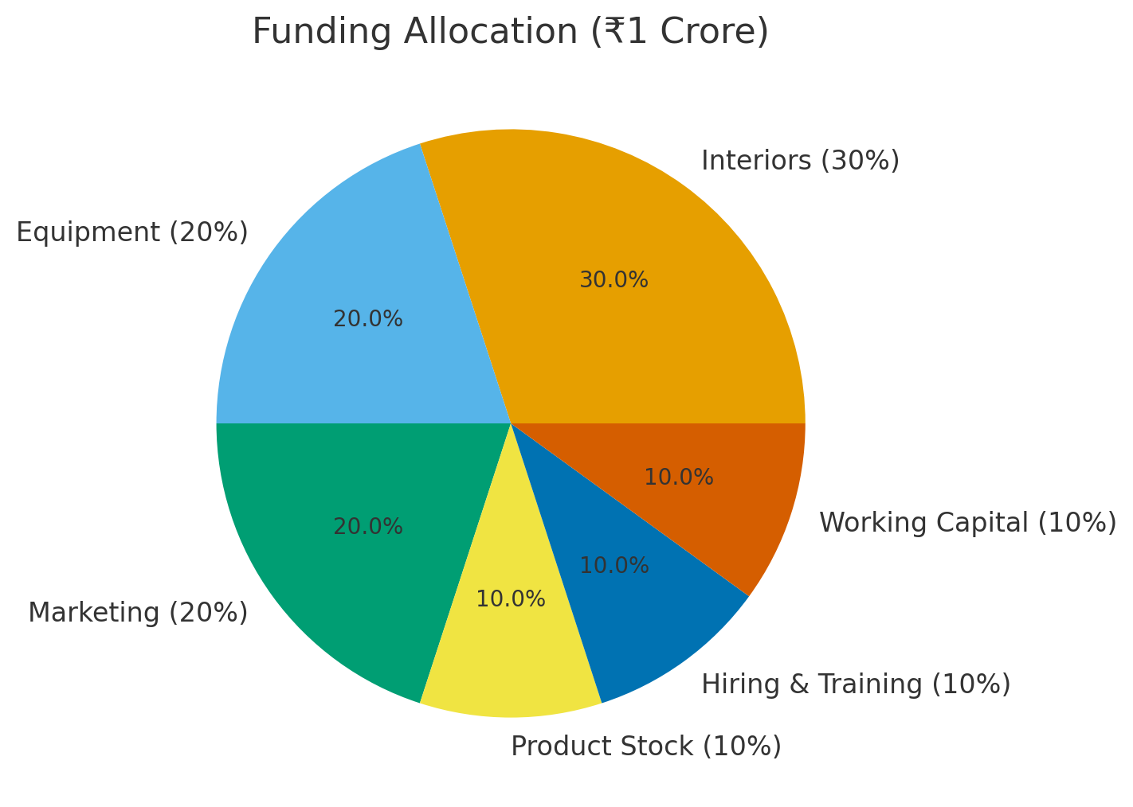

Financial Performance & Funding
Current Performance (2024)
Projected Growth (2025–2029)
₹50L
₹15L
4/1
Annual Revenue
Net Profit
Revenue Multiple
Current yearly turnover
30% profit margin
₹50L → ₹200L annual revenue in 5 years
60%
5/1
Profit Expansion
Repeat Rate
₹15L → ₹80L net profit demonstrating scalability
Customer retention
₹1.16 Crore
Annual potential at full operational capacity
675%+ upside compared to current revenues
Funding Proposal: ₹₹1,00,00,000
Allocation of Investment
Strategic Use of Funds
Premium Interior Upgrade
Create luxurious customer experience matching premium positioning
Advanced Equipment
Latest technology for expanded service offerings
Digital Marketing Campaign
Build brand awareness and customer acquisition across target markets
Second Outlet Launch
Establish presence in high-potential urban location
"With this investment, we project break-even in 10–12 months and an ROI exceeding 40% within 3 years."
Interiors
Equipment
Marketing
Product Stock
Hiring & Training
Working Capital

Slide 10



Growth Vision & Conclusion
Future Growth Opportunities
Beauty Training Institute
Specialized Bridal Centres
Pan-India Franchise Expansion
Launch certification programmes in hair, makeup, nail art, and skin care—creating an additional revenue stream whilst building a talent pipeline for expansion.
Dedicated bridal packages and male grooming centres capitalizing on high-value seasonal demand with premium pricing potential.
Replicate proven business model through franchise partnerships, enabling rapid geographic expansion with minimal capital investment.
5-Year Expansion Timeline
Year 1
1
Salon upgrade, digital branding launch, bridal specialist hiring, and process documentation
2
Year 2
Second outlet establishment in urban centre (Bareilly or Budaun) with refined operational systems
Year 3
3
Training institute launch and introduction of advanced service categories increasing per-customer value
4
Year 4
Third and fourth outlets, franchise model development, and regional brand establishment
Year 5
5
Franchise expansion across North India with 5+ operational locations and training academy
Investment Conclusion
4x Revenue Growth
40%+ ROI
Competitive Advantage
Projected scaling from ₹50L to ₹200L+ annually within 5 years through multi-location strategy
Strong return on investment with break-even achieved within first year of funded operations
Certified staff, modern services, and premium positioning create sustainable moat against competitors
Evanki Unisex Salon represents a compelling investment opportunity in India's rapidly growing beauty services market. With proven operations, strong customer loyalty, clear differentiation, and a scalable expansion strategy, we are positioned to deliver exceptional returns whilst establishing a leading regional brand.
This venture combines attractive financial projections with sustainable competitive advantages, making it highly appealing for investors seeking long-term growth in the consumer services sector.

